Slide 1
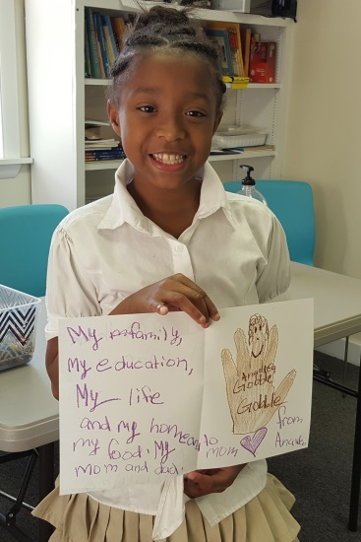
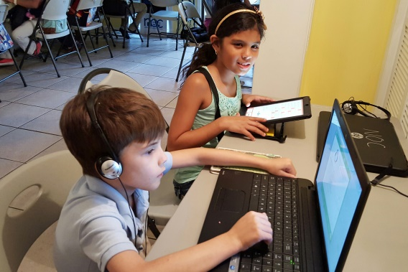
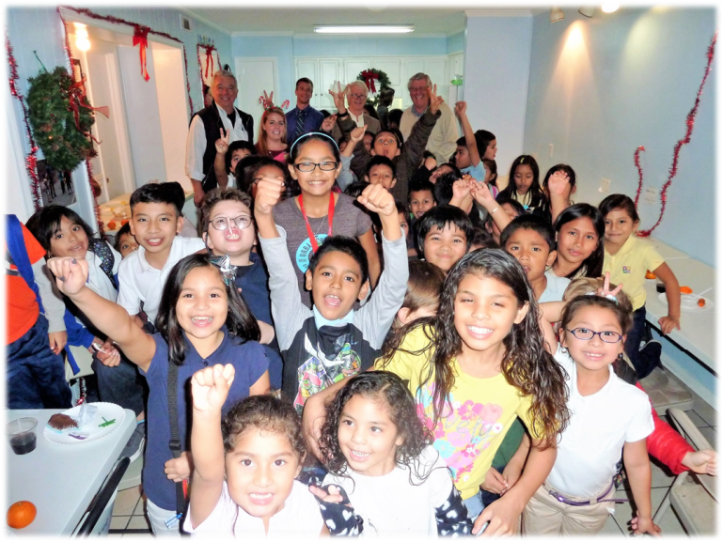
Together we can create pathways for people in need , enabling them to achieve economic and social progress and enjoy a better quality of life.
Narendra P. Sharma, PhD
Founder & Chair, NOC
NSharma/2022

Slide 2
Neighborhood Outreach Connection:
Driven by Its Vision, Mission, and Core Values
Vision : To create an even playing field so that people in low-income neighborhoods can achieve the “American Dream.”
Mission: To empower people living in poverty by creating opportunities for achieving economic independence, personal fulfillment, self-reliance, and dignity.
Core Values: Integrity, compassion, commitment.
NSharma/2022

Slide 3
NOC’s Innovative Development Approach & Business Model
NOC’s comparative advantages:
Strong presence in neighborhoods.
Strong relationships with parents, families, and community.
Teachers and school curriculum brought into centers.
Access to computers and the internet.
Proven track record in generating positive results.
Low cost in delivery of services.
Working with other service providers.
Be a caring neighbor … Together we can make a difference.
NSharma/2022

Slide 4
NOC Is Making a Measurable Difference…
NOC has 6 neighborhood learning centers (NLCs) in Beaufort County.
NOC serves more than 450 students, from Pre-K to Grade 8 … all on full scholarship.
>95% of students show progress in reading and math based on MAP test scores.
NOC allocates >90% of its resources to programs at a cost of less than $1,200 per student per year.
In 2022 , NOC has screened more than 360 people in the health sector in low-income neighborhoods .
NOC has benefited over 6,000 people through workforce development/community events since its inception.
NOC has been successful in community development (Oaks in HHI is an excellent example).
NSharma/2022

Slide 5
NOC’s Growth Path
First
10 years
(2008-2018)
Strong foundation , integrity, & reputation
Effective development approach & business model
Significant, measurable results
Nationally recognized social entrepreneurship
Cost effective delivery of services
NOC’s model & logo trademarked
Second
10 years
(2019-2028)
Expansion of programs in Beaufort County
Establishment of programs in SC & nationally
Building strategic partnerships and alliances in order to replicate NOC’s model beyond Beaufort County, led by local people and communities, with know-how & technical support from NOC
NOC recently replicated its business model in Lynchburg, VA, locally managed, operated, and funded.
NSharma/2022

Slide 6
NOC’s mantra…. Be a caring neighbor…touch the lives of people by connecting, listening, and helping them with love, compassion, and goodness.
“Learn from the people
Plan with the people
Begin with what they have
Build on what they know.
When the task is accomplished
The people … [will] remark
We have done it ourselves.”
Lao-Tzu
NSharma/2022

Slide 7
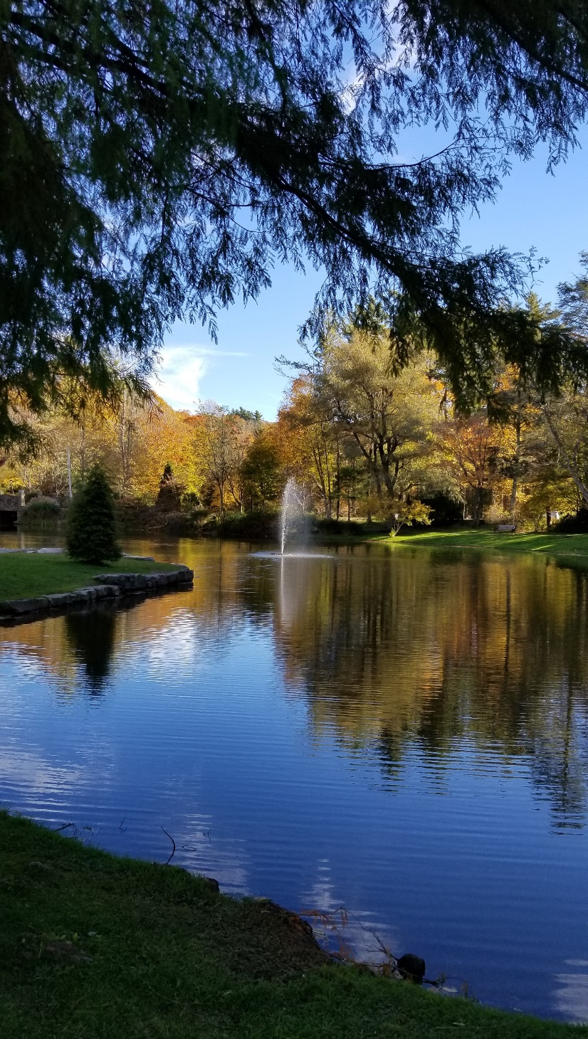
Reflections Cultivation of the soul…

Slide 8
Poverty … A Two-Edged Sword
Materialistic
approach to life
external
Poverty within us ... absence of inner peace and
Values such as love,
compassion, and goodness
self
world
NSharma/2022

Slide 9
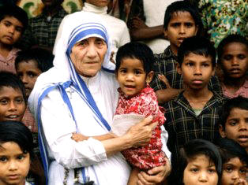
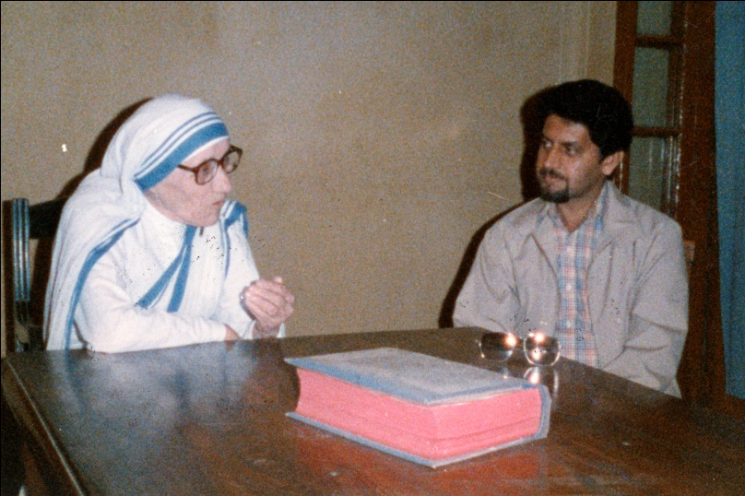
A Few More Words on Poverty
… millions of people … suffer such terrible loneliness and emptiness… They feel unloved and unwanted. These people are not hungry in the physical sense, but they are in another way.
Mother Teresa
NSharma/2022

Slide 10
Self Realization and Development
KNOWN
Expanding
frontiers through
self awareness and knowledge.
self
UNKNOWN
“When you try to understand everything, you will not understand anything. The best way is to understand yourself, and then you will understand everything.”
… Shunryu Suzuki
NSharma/2022

Slide 11
My Inspiration
The best way to find yourself is to cultivate your soul
through self awareness, knowledge, and service to others.
NSharma/2022

Slide 12
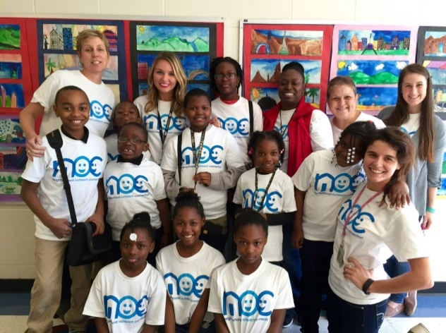
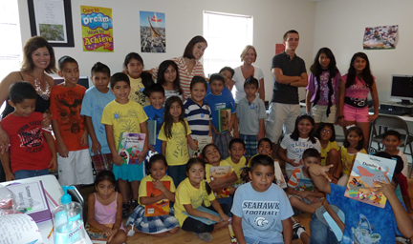
Website: http://www.noc-sc.org/
Address: P.O. Box 23558, Hilton Head Island, SC 29925
Telephone: 843-681-4100
Like us on Facebook & Instagram
NSharma/2022

